Slide 1



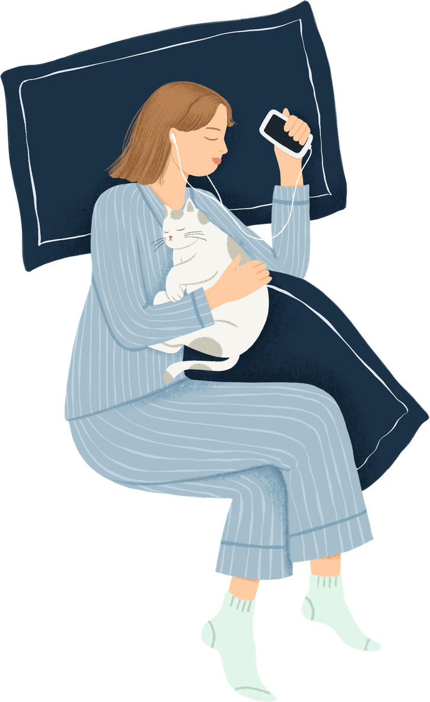

Sleep and Daily Habits
Ava Huffman

Slide 2


Introduction
Every day, our routines shape how well we sleep. Often, without us realizing it. From training or workloads and stress to screen time and hydration, small choices add up. This project explores how daily habits influence sleep quality and duration using the Sleep Health and Lifestyle dataset. By analyzing patterns across physical activity, stress, and health indicators, we can see what helps (or hurts) our sleep and overall how to make smarter choices.

Slide 3
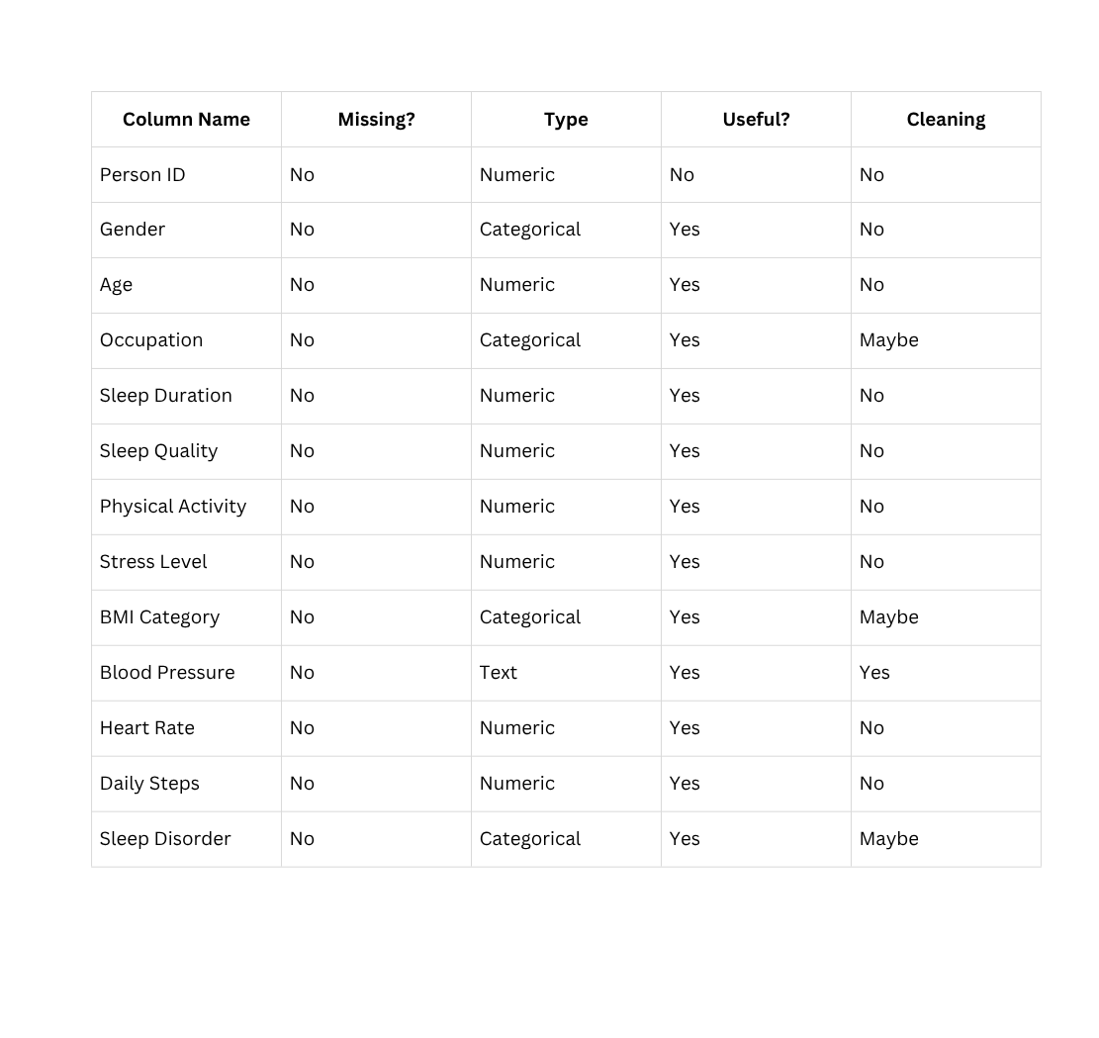
Data Overview
Dataset: Sleep Health and Lifestyle
Rows: 374 individuals
Columns: 13 variables

Slide 4




Key Questions
Does stress reduce sleep quality or duration?
How does age affect sleep patterns?
Are certain jobs tied to poor sleep or high stress?
Is BMI connected to sleep issues?

Slide 5
Audience & Purpose
College students and young adults, especially those balancing a heavy load like academics, training, and work. Overall Goal: Raise awareness about how everyday choices impact sleep. Empower students to adjust habits for better rest, recovery, and overall well-being.

Slide 6
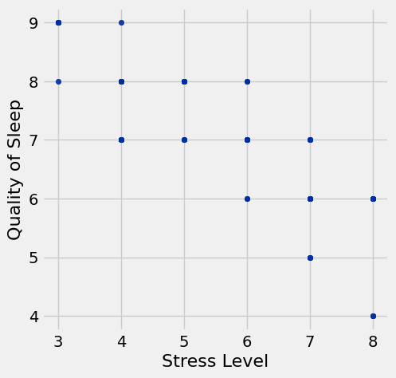
Stress vs Sleep Quality
The scatterplot shows a clear negative relationship between stress level and sleep quality. As stress increases, the quality of sleep tends to decrease. Although the individual days change, the overall pattern show that higher stress is linked to poorer sleep, indicating that stress may play an important role in how well someone sleeps.

Slide 7
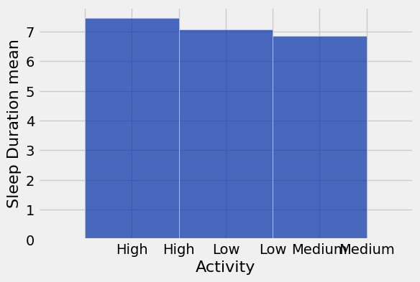
Physical Activity vs Sleep Duration
The graph suggests that sleep duration does not change drastically across activity levels. People with low, medium, and high physical activity all tend to sleep roughly the same amount, with only small differences between groups.

Slide 8
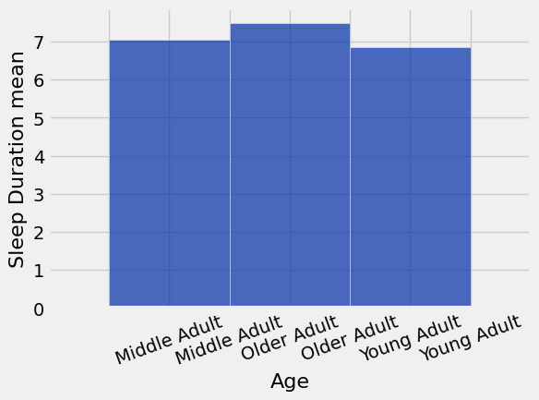
Age vs Sleep Duration
The bar chart shows the average sleep duration for three age groups: Young Adults (27–35), Middle Adults (36–45), and Older Adults (46+). Older Adults have the highest average sleep duration, followed closely by Middle Adults. Young Adults sleep slightly less on average. Overall, sleep duration increases slightly with age in this dataset.

Slide 9
Progress Slide
What I accomplished this week:
Plan for next week:
Obstacles and resources
Created three new data insight graphs (Stress vs Sleep Quality, Physical Activity vs Sleep Duration, Age vs Sleep Duration).
Making sure I am staying on top of my work
and when I need to submit everything. Also, looking
at any feedback I may have gotten.
Deciding which insights are the strongest for the final submission.
Resources I used
JupyterLab
Class lecture slides + Blackboard instructions

Slide 10

Feedback Slide From Mini update #2
Feedback I received
Additional feedback I am seeking
Which of my insights are the strongest for the final project?
Does my narrative match the level of detail expected?
Are my graphs clear and easy to interpret for someone who hasn’t seen the dataset?
“please follow format of profile data and add additional information”
Was the feedback useful?
Yes it helped me understand exactly what was expected and made my slides more organized and readable.

Slide 11
Mini update #3

Slide 12
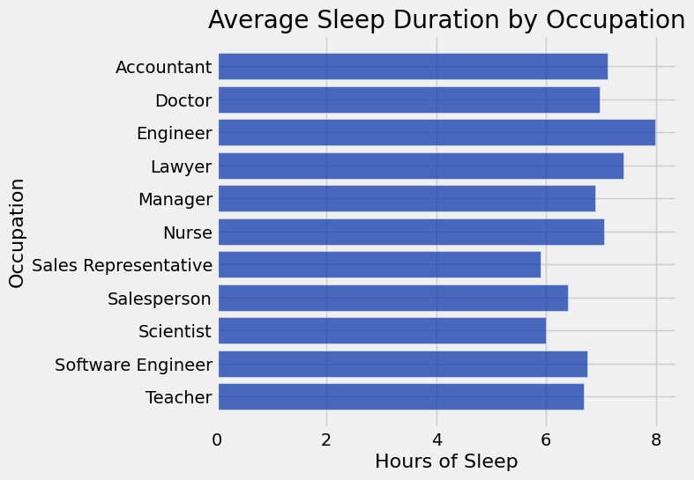
How does sleep duration vary across occupations
This graph shows how average sleep duration differs across occupations, revealing which jobs tend to get significantly more or less sleep. The most amount of sleep on the graph being Engineers with 8 hours and the least amount of Sleep being Sales Representatives.

Slide 13
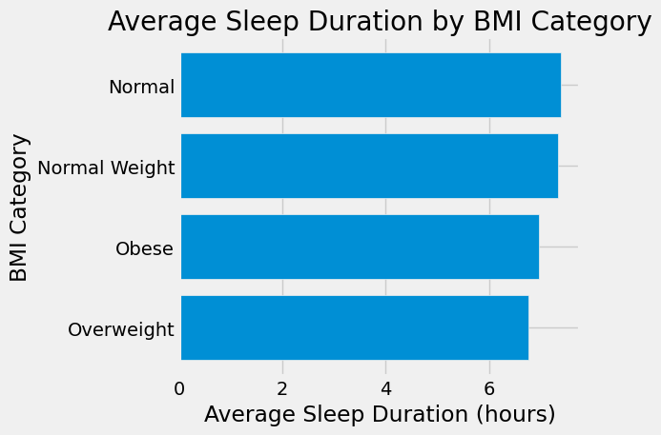
Is BMI connected to sleep issues?
This graph shows that the normal BMI gets on average 7 hours of sleep per night vs BMI that is considered overweight is less with under 7 hours of sleep per night. Highlighting how BMI can have an impact on your sleep.

Slide 14
What has accomplished and what is the plan for next week.
I accomplished fixing my feedback that was given from last week. I also analyzed two more questions I had.
What are the obstacles that you need help.
I just wanna make sure that Im doing everything properly.

Slide 15
Feed back:
The feedback from last week:
I was told to bin the age groups instead of using raw ages.
My physical activity graph looked strange because it only had a few data points, so I needed to double‑check the data.
I needed to make sure my plots were made inside the Python Notebook using the datascience package.
How I fixed it :
I checked the full dataset and created clear age bins (Young, Middle, Older).
I re‑binned Physical Activity into simple levels (Low, Medium, High) so each bar had enough data.
I remade all graphs in the Python Notebook using the correct data science functions.

Slide 16
Mini Update #4

Slide 17
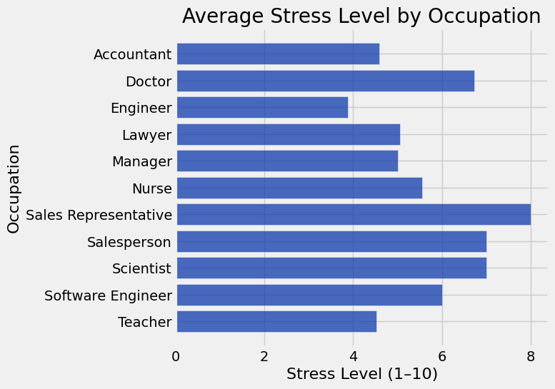
How does stress level vary across by Occupation?
This graph illustrates how average stress levels vary by occupation, showing which jobs experience consistently higher stress. As seen on this graph the stress levels are in a range from 1 being the lowest and 10 being the highest stress level. Sales Representatives are at the highest in the group of 8. The lowest of Engineers below a 4 in stress.

Slide 18
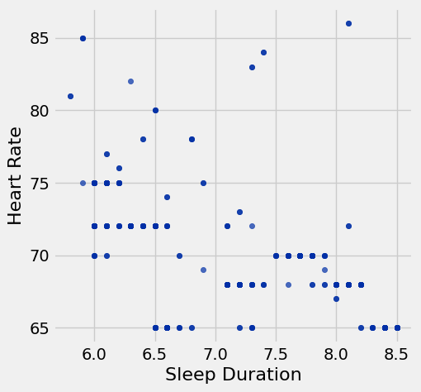
Does heart rate relate to sleep duration?
The scatter plot reveals a downward trend, where individuals with longer sleep durations generally show lower heart rates, indicating that increased sleep may support healthier recovery and reduced strain. The lowest being near 8.5 hours of sleep with a 65 average Heart Rate, supporting that idea.

Slide 19
What has accomplished and what is the plan for next week.
I accomplished fixing my feedback that was given from last week. I also graphed two new questions and filled out the rest of the slides.
What are the obstacles that you need help.
I just wanna make sure that I'm doing everything properly.

Slide 20
Feed back:
The feedback from last week:
“this plot is too busy, you can consider split into two for sleep duration and stress level, if you would like to show the relationship between sleep duration and stress level, then use a scatter plot”
“uhm, this is a type "ugly" plot, the bar are so close to each other, consider horizontal bar, please check out the resourced introduced in today's class today”
How I fixed it :
I split the original busy plots into two different questions. One showing sleep duration by occupation and the other showing average stress levels/
I used a scatter plot to show the relationship between sleep and stress
I switched to a horizontal bar chart to improve spacing
I reviewed class resources and applied the recommendation to practice my plots so it is easier to interpret.

Slide 21
Mini update #5

Slide 22
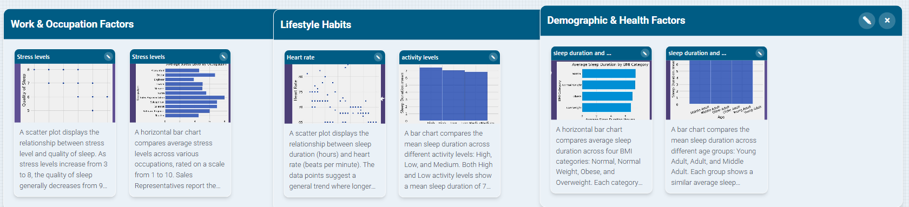
Story Studio
This data story is organized into three themes to show how different factors influence sleep. The first section focuses on work and occupation, showing how job type affects sleep duration. The second section highlights lifestyle habits, including physical activity and heart rate, and how they relate to sleep. The final section examines demographic and health factors, such as age and BMI, to show how personal characteristics shape sleep patterns. Together, these insights show that sleep is influenced by a combination of work demands, daily habits, and individual health factors.

Slide 23
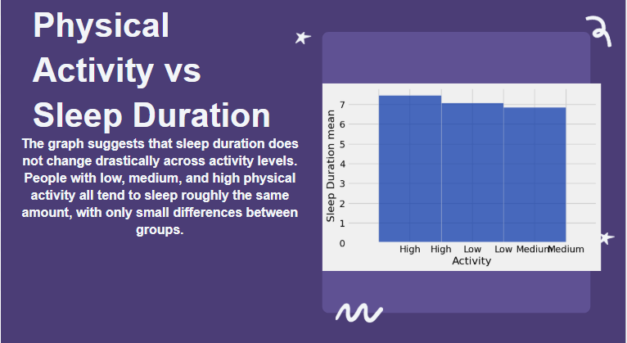
In the Sleep Health and Lifestyle dataset, I focused on the relationship between physical activity level and sleep duration. The data shows that people with higher activity levels tend to sleep slightly longer than those with lower activity levels. Even though the difference isn’t dramatic, the pattern is consistent: movement supports better rest. This insight stood out to me because of my own experience as a student‑athlete. On days when I train hard or get a lot of steps in, I fall asleep faster. But when I tend to have my rest day, I have more stressful days, my sleep feels shorter and less refreshing.
Seeing this pattern in the dataset helped me realize that my habits actually reflect real data. It reminded me that staying active isn’t just about performance, it’s also about recovery and mental health. This matters to other students too, especially those balancing school, work, and personal responsibilities. Many people underestimate how much daily movement affects their sleep and energy. By understanding this connection, we can make small changes that lead to better rest, focus, and overall well‑being.

Slide 24
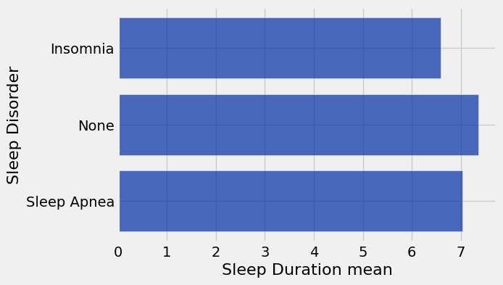
Does sleep disorders affect sleep?
This graph compares the average sleep duration for people with different sleep disorder statuses: Insomnia, Sleep Apnea, and None. The results show a clear pattern. Individuals with no sleep disorder get the most sleep on average, slightly above 7 hours. Those with Sleep Apnea sleep a little less, around 7 hours. People with Insomnia get the least sleep, averaging just under 7 hours. Overall, the graph suggests that having a sleep disorder especially insomnia is linked to shorter sleep duration.

Slide 25
What has accomplished and what is the plan for next week.
I accomplished using story studio and writing a Micro story draft and filled out the rest of the slides.
What are the obstacles that you need help.
I overall just had trouble trying to group and explain my data but after some trial and error I found a good way to explain which helped me understand the data story more.

Slide 26
Feed back:
The feedback from last week:
All I received was that my graphs looked better
How I fixed it :
I overall made my graphs more clear and focused on making sure I highlighted one dataset at a time so it did not look messy. I also learned more about using Story Studio which In returned helped me explain my data set more clearly

